Slide 1
DBMS- Session1

Slide 2
Course Objective
To understand Data Storage
Advantages of using DBMS
To understand Data models and its types
To understand Database keys and its types

Slide 3
Session Objective
Data Storage
Data Models
Database Keys

Slide 4
Data Storage
Information storage and retrieval (data processing) is a major part of the software application development in the IT industry.
It is mandatory for every software professional to be aware of the approach of data storage and retrieval systems

Slide 5

Data and information
Data: Known facts, figures, objects and events which can be stored
Structured: numbers, text, dates
Unstructured Data: images, video, documents
Examples:
RDBMS 02/01/2016 “It is raining”
Information: Data that is processed to be useful
Examples:
Course Code is 1
The course name is RDBMS
The begin date of course is 02/01/2016
The temperature dropped 20 degrees and then it started raining.
Notes:
Data: symbols Information: data that are processed to be useful; provides answers to "who", "what", "where", and "when" questions Data... data is raw. It simply exists and has no significance beyond its existence (in and of itself). It can exist in any form, usable or not. It does not have meaning of itself. In computer parlance, a spreadsheet generally starts out by holding data.
Information... information is data that has been given meaning by way of relational connection. This "meaning" can be useful, but does not have to be. In computer parlance, a relational database makes information from the data stored within it.

Slide 6
Traditional approach
The traditional approach to store and access the data is file based system
File-based System
Data are stored as collection of records in flat-files (data files) on the disk
Collection of application programs that perform services for the end users (e.g. reports) access these data files
Each application defines and manages its own data
6

Slide 7
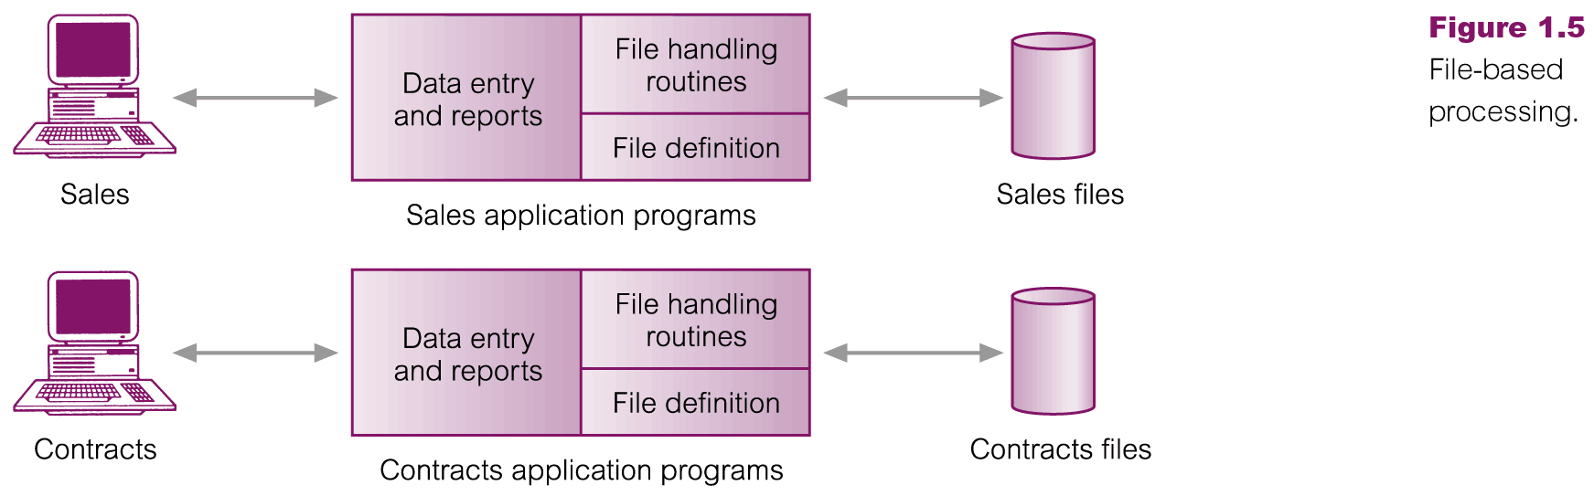

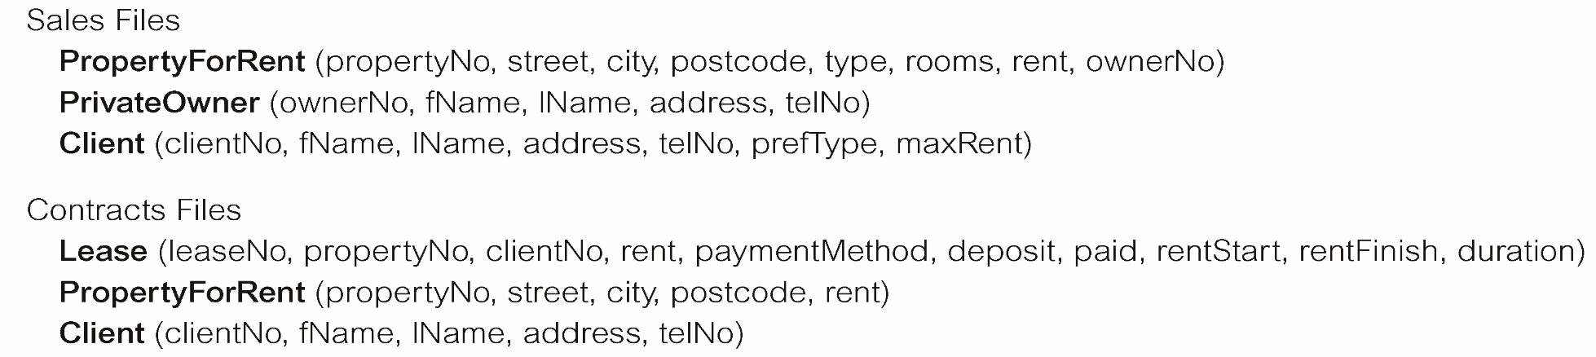
How traditional approach works?
File Based Processing
7

Slide 8
Limitations of traditional approach
Separation and isolation of data
Each program maintains its own set of data.
Users of one program may be unaware of potentially useful data held by other programs.
Duplication of data
Same data is held by different applications.
Wasted space and potentially different values and/or different formats for the same item.
No Concurrent access to data
No simultaneous application access to data
No data independence
File structure is defined in the program code
8

Slide 9


Database approach
Data is stored in the database as a collection of data files
Database:
A collection of related data.
Database Management System (DBMS):
A software package/ system to facilitate the creation and maintenance of a computerized database.
Database System:
The DBMS software together with the database
9

Slide 10
Advantages of database approach (DBMS)
Control of data redundancy
Data consistency
Program-Data independence
More Secure
Concurrent access to data through application programs
Flexible for application development
10

Slide 11
Data Model
What is data model?
Integrated collection of concepts (Tool) for describing data, relationships between data, and constraints on the data in a database
Why data model?
To represent data in an understandable way.
Types of data models include:
Object-based
Record-based
Physical
11

Slide 12
Types of data model
Object-Based Data Models
Entity-Relationship
Semantic
Functional
Object-Oriented.
Record-Based Data Models
Relational Data Model
Network Data Model
Hierarchical Data Model
Physical Data Models
12

Slide 13
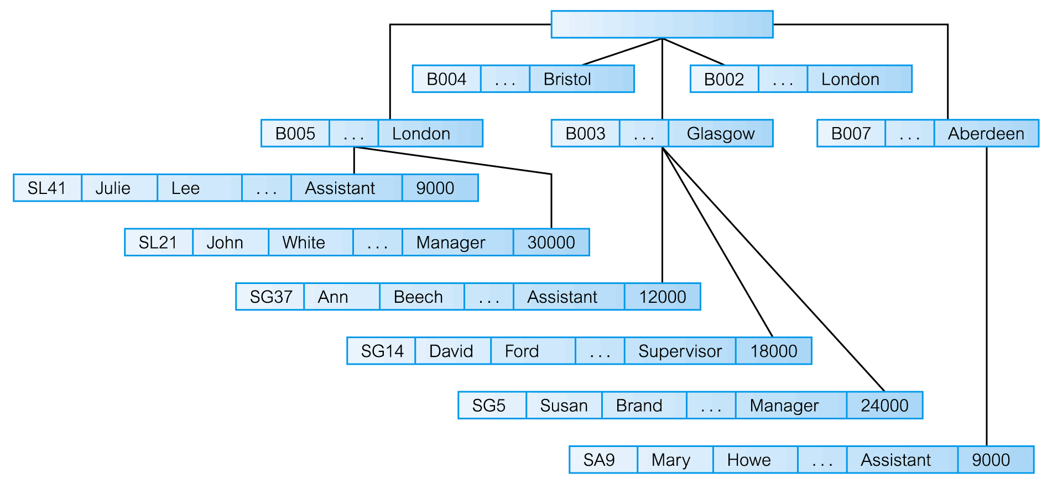
Hierarchical Data Model
13

Slide 14
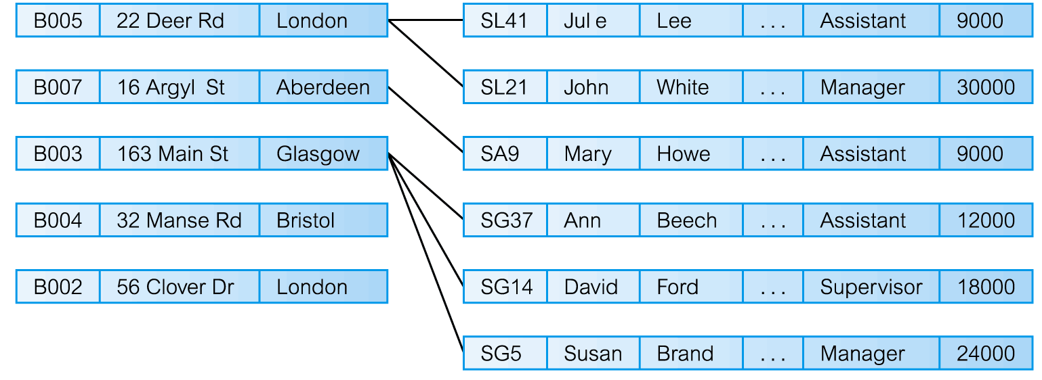
Network Data Model
14

Slide 15
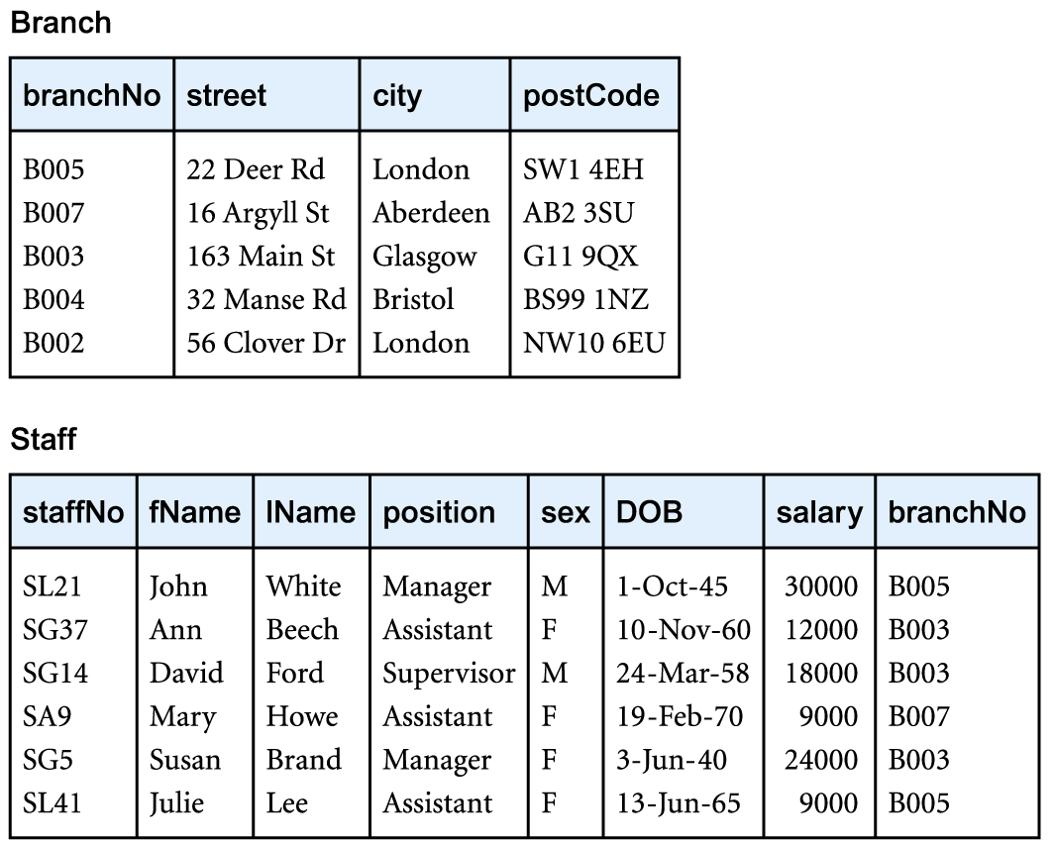
Relational data model

Slide 16
Relational data model contd…
Relational Model:
Proposed in 1970 by E.F. Codd (IBM), first commercial system in 1981-82.
Now in several commercial products (e.g. DB2, ORACLE, MS SQL Server, SYBASE, INFORMIX).
Several free open source implementations, e.g. MySQL, PostgreSQL

Slide 17
Relational Model Terminology
A table with columns and rows.
Only applies to logical structure of the database, not the physical structure.
Attribute is a named column of a relation.
Domain is the set of allowable values for one or more attributes
Tuple is a row of a relation.
Degree is the number of attributes in a relation.
Cardinality is the number of tuples in a relation.
Relational Database is a collection of normalized relations with distinct relation names

Slide 18
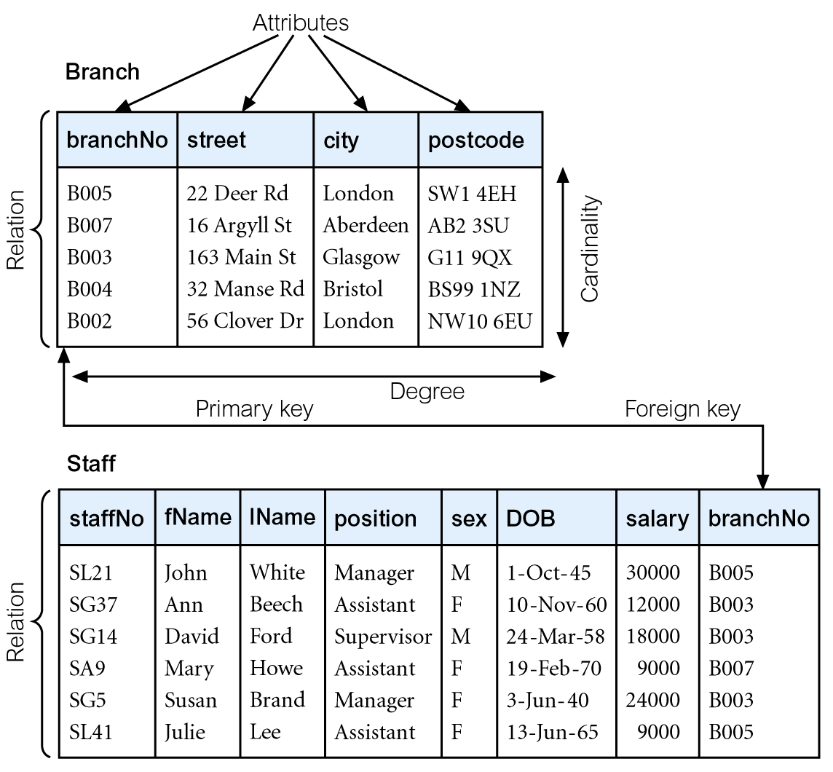
Relational Model Example

Slide 19


Data Base Keys

Slide 20
Keys
A key is a one or more attributes, used to identify a record in a relation/table
Relation model support different types of keys
Candidate key
Super key
Foreign key
Alternate key
Primary key
Composite key

Slide 21
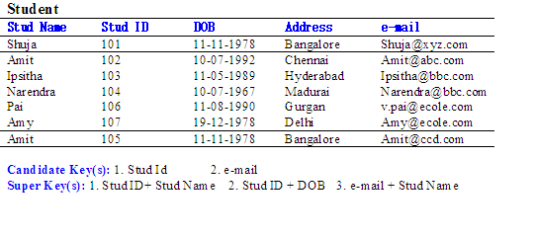
Keys contd…
Candidate Key
One or more attributes, which is used to uniquely identify a record in a relation
Super key
One or more attributes, which is used to uniquely identify a record in a relation
super set of candidate key i.e., Candidate key + non key attributes

Slide 22
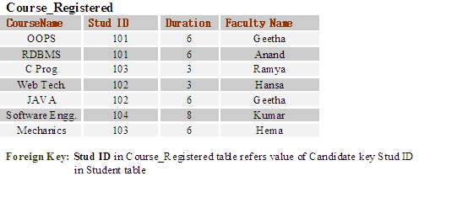
Keys contd…
Foreign Key
Used to relate one or more relations/tables
One or more attributes, which is used to refer value of a candidate key in the same relation or a different relation
Alternate Key
Candidate keys that are not selected to be primary key

Slide 23
Keys contd…
Primary Key
One or more attributes, which is used to uniquely identify a record in a relation
Used in table creation
If a relation has several candidate keys, one is chosen arbitrarily to be the primary key
Example: Primary key: Stud ID

Slide 24
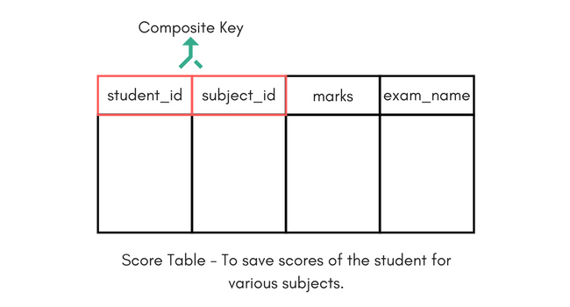
Keys contd…
Composite Key
A composite key is a set of more than one key that, together, uniquely identifies each record.
For example,
Score table:
The Score table which stores the marks scored by a student in a particular subject.
In this table Student_id and Subject_id together will form the primary key,
hence it is a composite key.

Slide 25

Video on Keys
Objective:
To make the Trainee understand the concept of Database keys.
Video Path:
https://www.youtube.com/watch?v=JkwbhFUftSc

